Slide 1
READ ME This template uses the font ‘Space Grotesk’ – be sure to download the font before making edits to the deck. Here’s the link to the ZIP file containing the font. If you cannot access the link above, you can download the font for free via Google Fonts.

Slide 2
What’s New with .NET MAUI Matthew Leibowitz – .NET MAUI Engineer at Microsoft @mattleibow

Slide 3

.NET Multi-platform App UI (MAUI)
Single project system, single codebase
macOS
iOS
WinUI
Mac Catalyst
iOS
Android

Slide 4









Build anything with a unified platform
.NET
Cloud
Web
Desktop
Mobile
Gaming
IoT
AI
+
+
Visual Studio
Visual Studio Code
CLI
Linux
NuGet
Github
Components, tools, library vendors
Windows
macOS
Tools
Operating system
Ecosystem

Slide 5

.NET offers choice for developers
BLAZOR
C#, HTML, CSS
BLAZOR + .NET MAUI
.NET MAUI
C#, XAML
Reach
Depth
Websites and PWAs
Hybrid
Native

Slide 6


Blazor hybrid apps
Native app container & embedded controls
Fully native web UI through platform WebView
Multi-platform with MAUI abstractions
No internet required
Store distribution and reach
Blazor
Razor Components
BlazorWebView
.NET MAUI
Native APIs
WinUI
Mac
Catalyst
iOS
Android
macOS
iOS

Slide 7
.NET MAUI in .NET 8
Improved performance and memory management
New hybrid and desktop app features
Flexible tooling for development
Tons of bug fixes and stability work
dot.net/maui

Slide 8
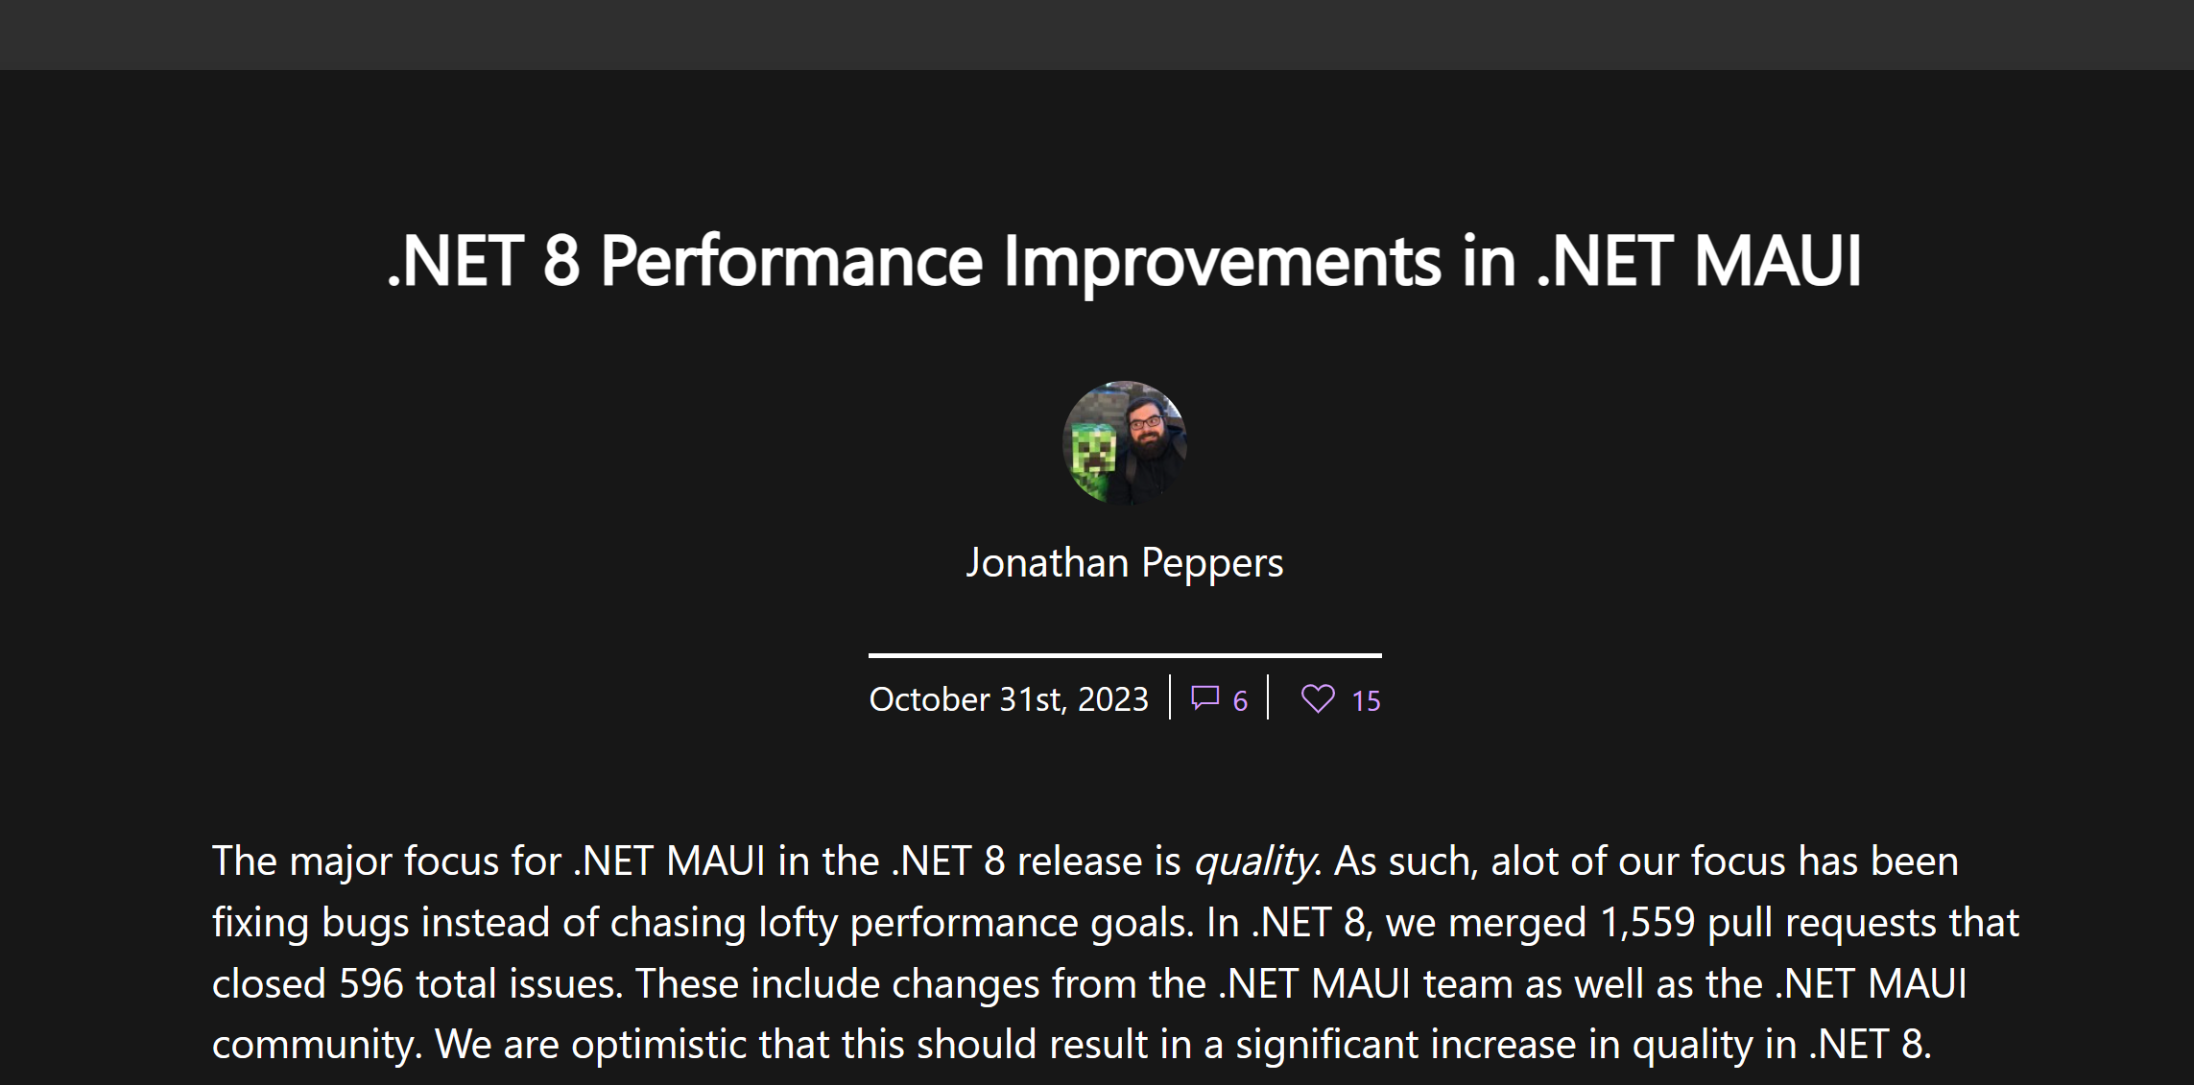
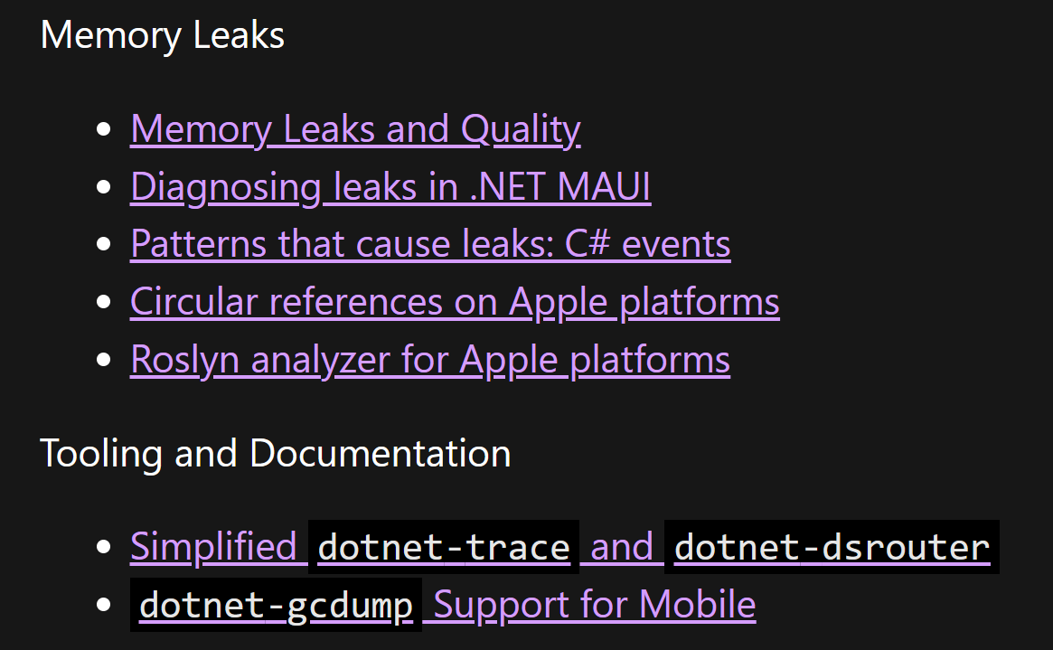
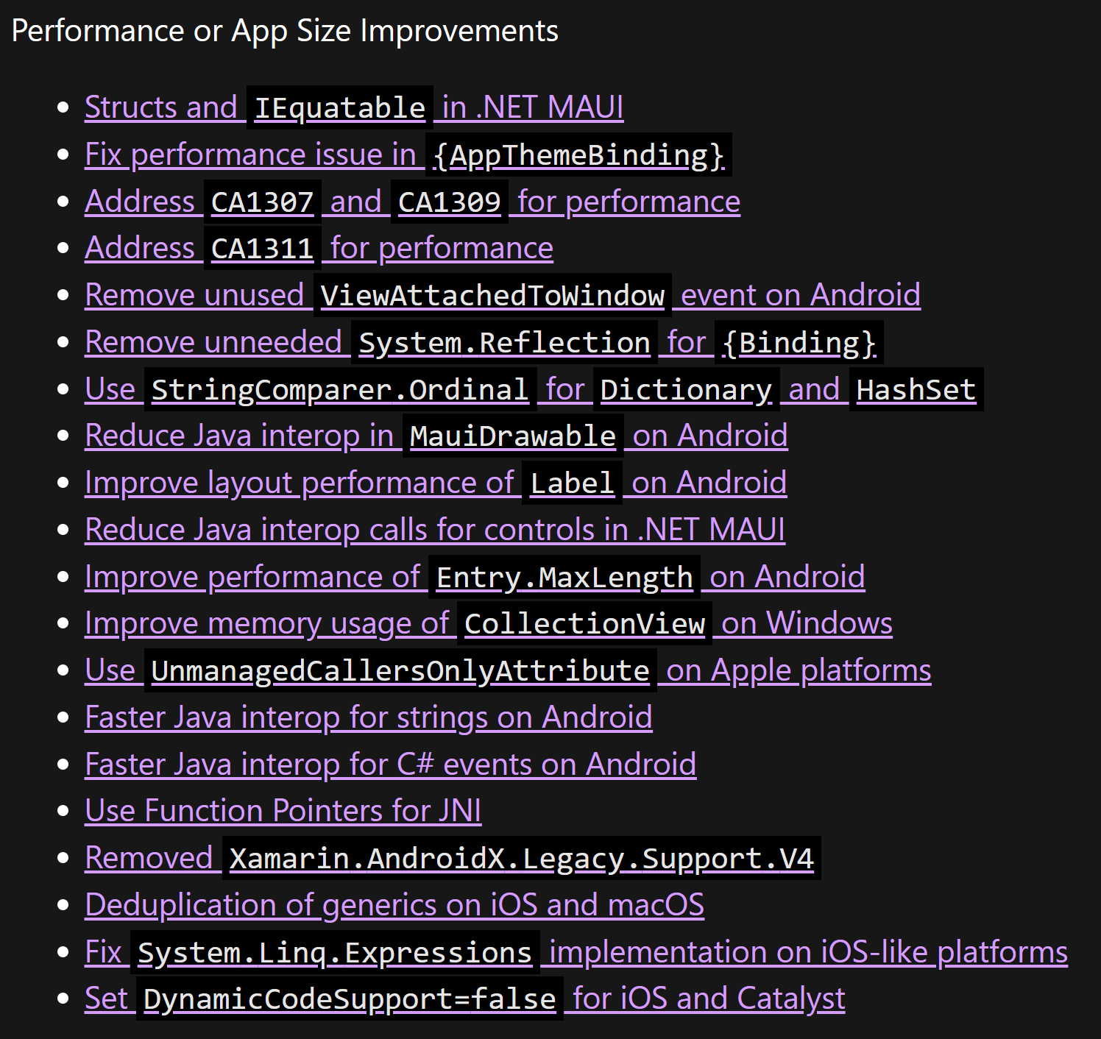
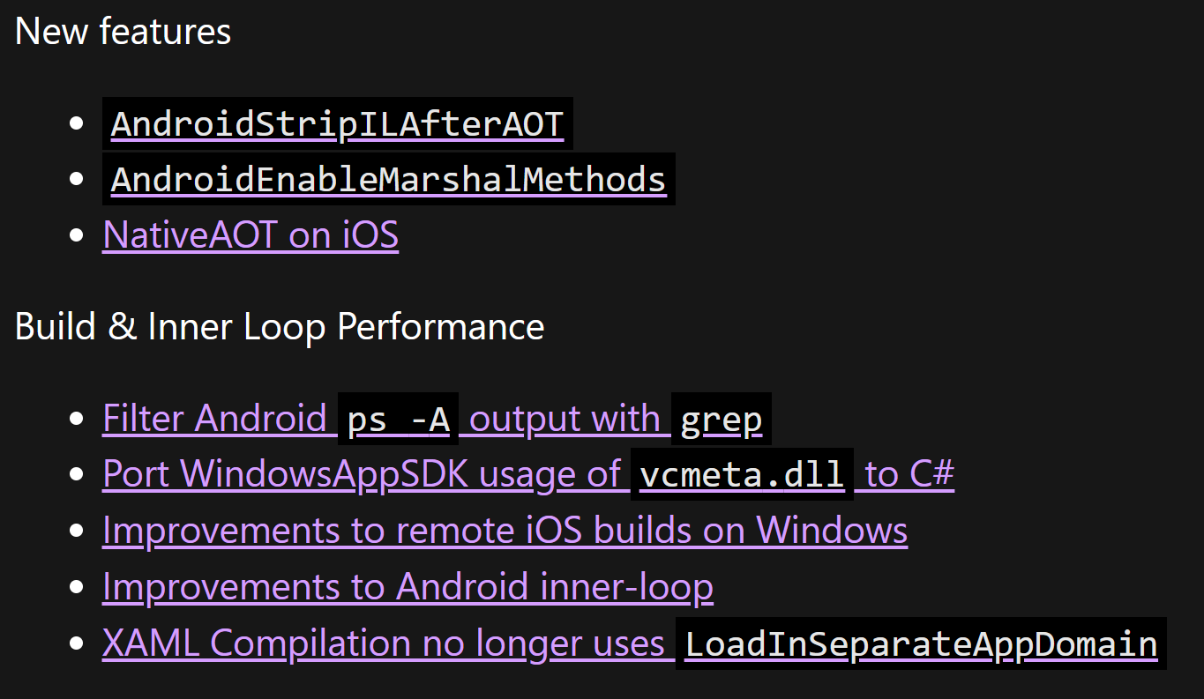
aka.ms/mauiperf8

Slide 9
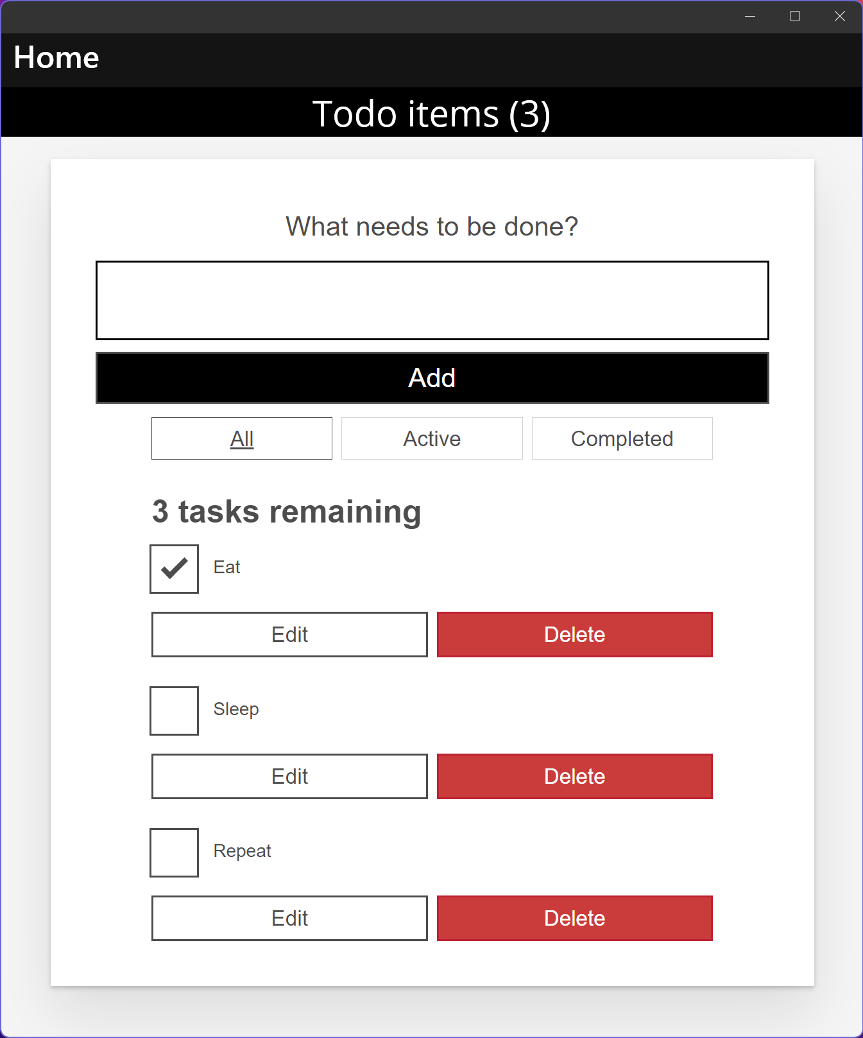
.NET MAUI HybridWebView Experiment
Multi-platform control based on .NET MAUI WebView
Host static web assets (HTML, JS, CSS, etc.)
Communicate between JavaScript & .NET
Reuse your Angular, React, etc. investments in MAUI native desktop and mobile apps
Use any web-based UI and it can interact with C# code
github.com/Eilon/MauiHybridWebView
Native app container & controls
Hybrid WebView React JS

Slide 10
Desktop Development
.NET 7
.NET 8
Tooltips
Pointer hover
Right-click & context menus
Custom keyboard accelerators
Drag and drop gestures
Pointer gestures for pressed & released

Slide 11
Visual Studio 2022 productivity
Intelligent code editing
AI-assisted development
Live Share remote collaboration
C#, XAML, Razor IntelliSense
Rapid iteration
Hot reload XAML, C#, Razor, CSS, and more
Preview and Inspect UI at debug time
Develop for anything, anywhere
Use Android emulators & devices
Develop iOS directly from Windows
Use iOS simulators via Xcode

Slide 12
Last but not least
Fixes related to…
CollectionView
TabBar visibility
RoundRectangle Borders
Android text alignment
Drag-and-drop functionality
Tab bar appearance
CheckBox
RefreshView
SwipeItem
Label
Button
Border clipping
Window glitches
Image loading problems
Cursor preservation in text boxes
Menu key accelerators
InputTransparent behavior permutations
Fonts
Navigation
Tabs
File picker
Entry visibility under keyboard
iOS SafeArea
Downscaled iOS images
Removal of Rosetta
Unpackaged WinUI apps
Width & Height requests
Platform consistency
NREs & crashes
…and much more!!!

Slide 13
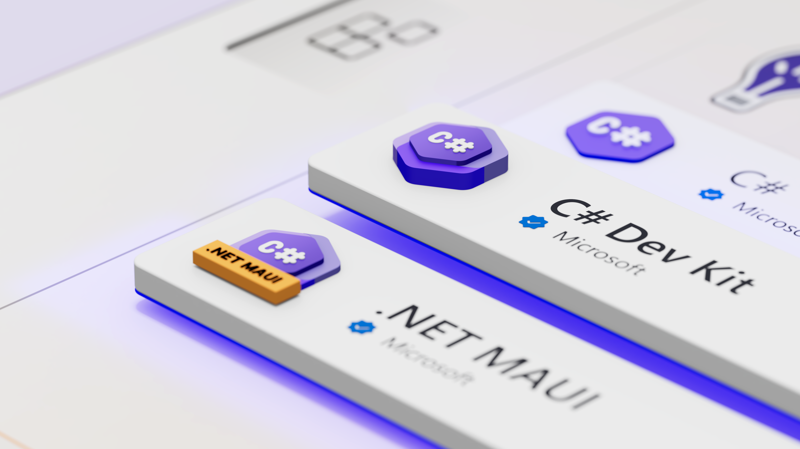
aka.ms/csdevkit
aka.ms/mauidevkit

Slide 14
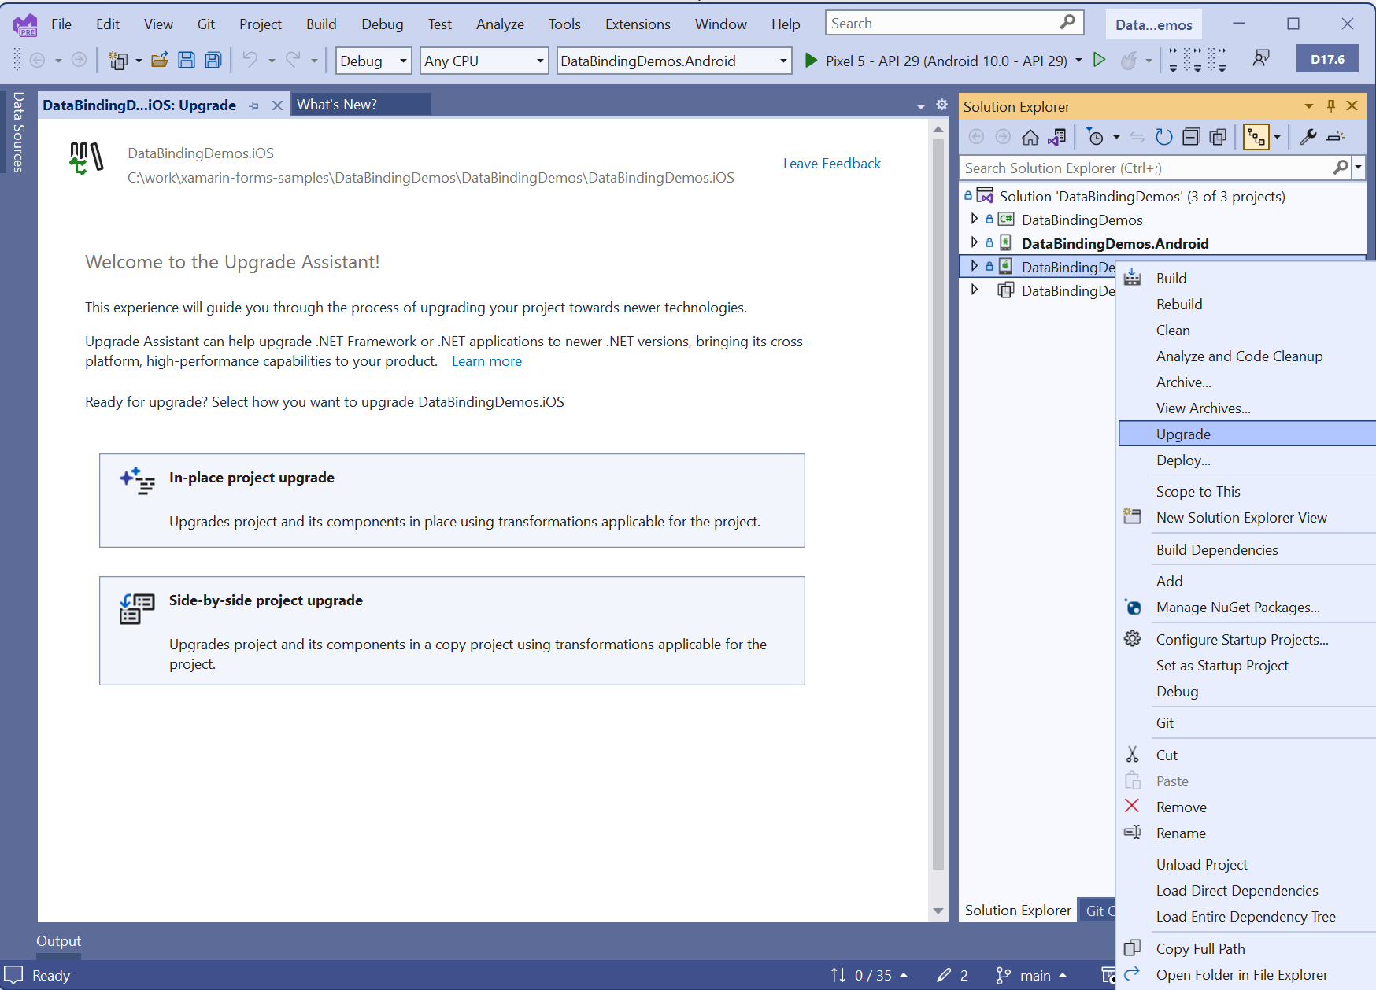
.NET Upgrade Assistant for Xamarin Projects
Highlights:
Converts projects
Replaces known NuGet packages
Fixes namespaces
Fixes base types
Applies various code updates
Also can help you upgrade from .NET 6/7 to .NET 8!
maui-upgrades@microsoft.com

Slide 15
Desktop in .NET 8
Demo

Slide 16












Thank you to our SPONSORS
Gold Sponsors
Silver Sponsors
Swag Sponsors

Slide 17


Slide 18
Thank you!
dot.net/maui

